Slide 1
Electricity Demand Forecasting
Brad Painting
Mentor: Dhiraj Khanna

Slide 2
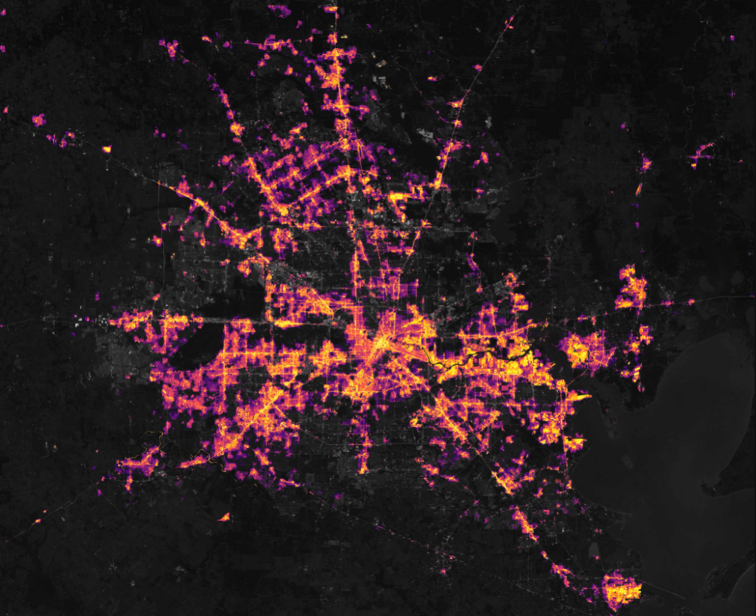
Problem Definition
Context
Electricity is not easily stored.
Electric demand in the Carolinas regularly fluctuates between approximately 15,000 MW and 40,000 MW.
Power producers must anticipate market demand in order to place bids on their electricity production.
Large-scale forecasting errors can lead to power shortages and blackouts.
Possible Stakeholders
Power producers, regional balancing authorities
Satellite image of power grid blackout in Houston

Slide 3
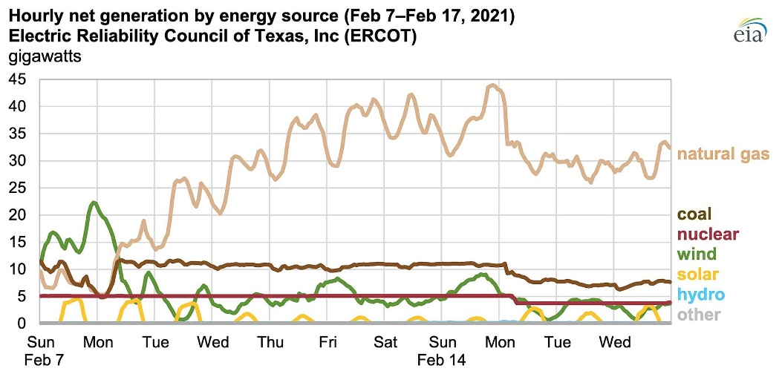
Real-World Example
In February 2021, record low temperatures in Texas caused a mismatch between electric supply and demand, causing surging power costs and leaving 4.5 million people without power.
*The situation was complicated by frozen pipelines and mechanical failures.

Slide 4
Criteria for Success and Constraints
Goal: Predict hourly electric demand (in MW) over a 24-hour horizon with a MAPE less than 10%
Scope and Constraints:
Focus on Carolinas (North + South Carolina)
Limit exogenous variables to temperature
Only observed temperature is available; must emulate 1-day temperature forecasts

Slide 5
Datasets
Key Sources
Electric Demand from EIA API (Energy Information Administration)
Temperature Data from NCEI API (National Centers for Environmental Information)
Descriptions
Electricity Demand Data: 25,749 row timeseries @ hourly intervals
Raleigh weather data: 34,825 row timeseries @ irregular intervals
Columbia NC weather data: 39,381 row timeseries @ irregular intervals
EIA Day-Ahead Forecasts: 25,775 row timeseries @ hourly intervals

Slide 6
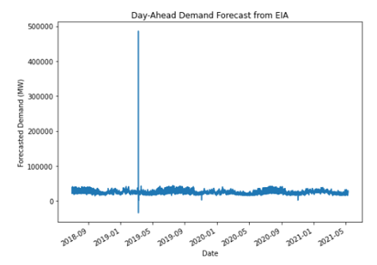
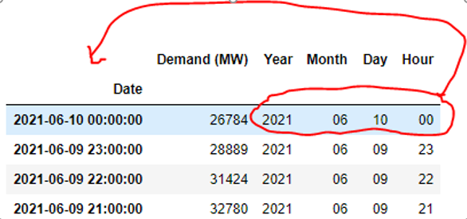

Data Wrangling
Convert JSONs → Pandas dataframes
Reformat datatypes; e.g. string-type dates into datetime
Remove non-numeric characters and backfill missing values
Resample observed temperature to 1-hour intervals
Incorporate errors in temperature to emulate forecasts
Merge temperature and demand data on index
Clean anomalies from EIA benchmark data

Slide 7
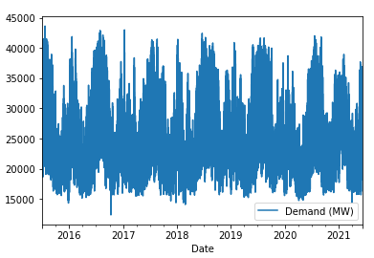
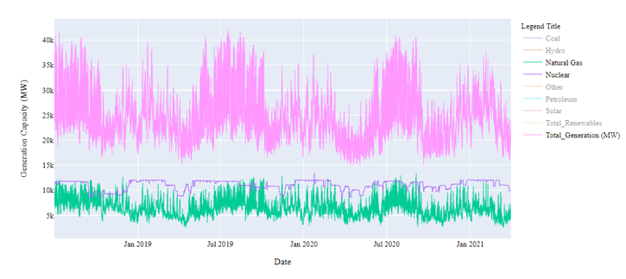
Exploratory Data Analysis
Start with a general high-level look at the data
Demand Time Series
Generation Time Series

Slide 8
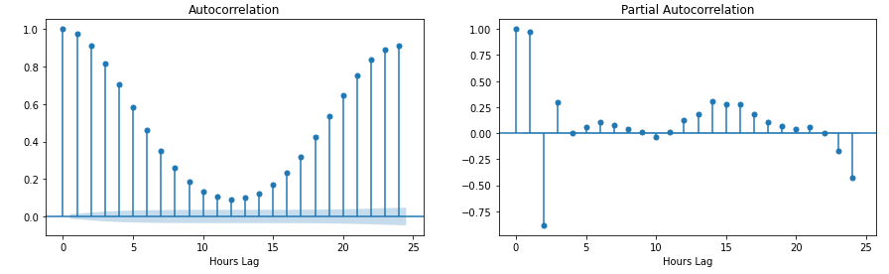
Exploratory Data Analysis (Cont.)
Investigate the ACF and PACF of Demand

Slide 9

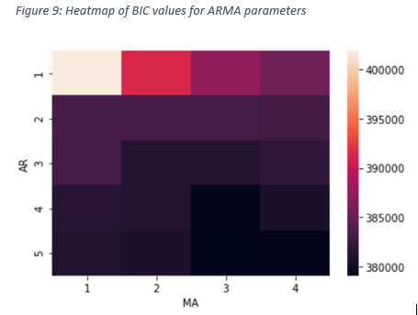
Modeling
Determine order of differencing required to pass KPSS and make data stationary (d=1)
Tune AR and MA lags based on lowest BIC; select ARIMA(4,1,3)
Try ARIMA, ARIMAX, and Facebook Prophet Models

Slide 10
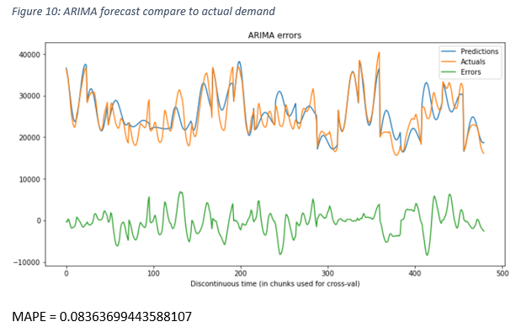
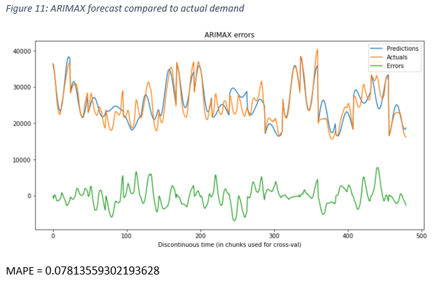
Analysis of Results
ARIMA
ARIMAX

Slide 11
Recommendations for Prospective Clients
The current ARIMAX model underperforms forecasts by the Carolinas balancing authority. However, the model can potentially be used to:
Detect data errors in forecasts received from EIA
Augment existing forecast methods with machine learning as an ensemble of different methods
Help develop confidence intervals on forecasts
Substitute weather and demand datasets for different regions to automate forecasting

Slide 12
Practical Considerations and Suggestions
Experiment with smaller regions so that temperature data is more closely coupled to demand data
Experiment with other exogenous variables:
rainfall,
wet-bulb temperature
solar irradiance
schedule of holidays or special events

